Slide 1
Volunteer Management System
Presented by Team SE18-08S

Slide 2
Content
Introduction
Use Case Modeling
Software Architecture
Demonstration of Prototype
Transition Strategy
Project Progress
Management Problems
Challenges
Q & A

Slide 3

Introduction
Volunteer Management System

Slide 4
Introduction – Recap of Requirements
Volunteer Management
Staff Management
Project Management
Itinerary Management
Administration

Slide 5
Use Case Modeling
Volunteer Management System

Slide 6
Use Case Modeling – Overview of Use Cases
Objective of Non-Government Organisation (NGO) – Eliminate poverty
Has grown tremendous over the years which attracts more volunteers.
A need to coordinate and manage the volunteers.
Manual handling of paperwork and volunteers requires lots of work and limits the efficiency of the organisation.

Slide 7
Use Case Modeling – Analysis of Use Case 1
Objective of Non-Government Organisation (NGO) – Eliminate poverty
Has grown tremendous over the years which attracts more volunteers.
A need to coordinate and manage the volunteers.
Manual handling of paperwork and volunteers requires lots of work and limits the efficiency of the organisation.

Slide 8
Use Case Modeling – Analysis of Use Case 2
To provide an integrated system with the aim of addressing the problems of volunteer communication, documentation, recruitment and retention.

Slide 9
Software Architecture
Volunteer Management System

Slide 10
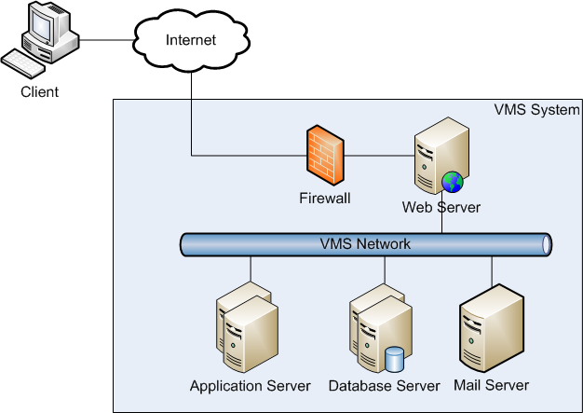
High Level Architecture –Architecture Overview

Slide 11
High Level Architecture –Architecture Overview
Web Server
Apache 2.2
Apache Load Balancer (JK module)
Application Server
Tomcat 6.0
Database Server (RDBMS)
Microsoft SQL Server 2008
Mail Server
POP Mail server (eg. Gmail)

Slide 12
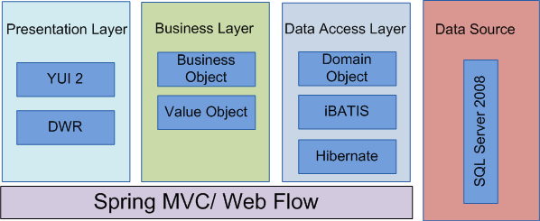
High Level Architecture – Framework Overview

Slide 13
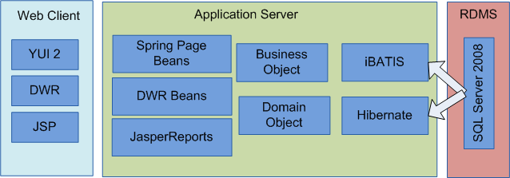
High Level Architecture – Overview of Components

Slide 14
Demonstration of Prototype
Volunteer Management System

Slide 15
Demonstration of Prototype
Technical Prototype
User Interface Prototype

Slide 16
Transition Strategy
Volunteer Management System

Slide 17
Transition Strategy – Analysis to Design
Project Planning
Analysis and Design
Prototyping
Use Case Modeling
Use Case Realisation Report
High-level System Design
Software Architecture
Transition Strategy from Analysis to Design
Project Management

Slide 18
Transition Strategy – Analysis to Design
No | Task | Description | In-Charge
1. | Prototyping | User interface prototyping Technical prototyping | Feng Yan, Jifa Zaw
2. | Use Case Modeling | Use case model survey | Thida, Hazel
3. | Use case realisation report | Use case realisation report | Thida, Hazel
4. | Software Design | High level software architecture design document | Zaw
5. | Transition Strategy from Analysis to Design | Transition Strategy from Analysis to Design | Zaw
6. | Project Management | Transition Strategy from Analysis to Design | Dio

Slide 19
Transition Strategy
Active member involvement
Involve all team members by clear and thorough communication
Clearly define roles and responsibilities
Assign tasks to staff by capability and experience
Active risk management
Anticipate risk early, accept and mitigate following the risk management techniques
Enforce tracking practices
Monthly progress update

Slide 20
PROJECT Progress
Volunteer Management System

Slide 21
Project Progress
No | Activity | Planned Start Date | Planned End Date | Actual Start Date | Actual End Date | Planned Effort | Actual Effort | Task Status | Comments
1 | Project Planning
1.1 | Produce Project Plan | 21 Jan 2011 | 02 Apr 2011 | 20 Feb 2011 | 09 Apr 2011 | 7 | 9 | Done | Requirements gathering issues.
1.2 | Produce Quality Plan | 21 Jan 2011 | 02 Apr 2011 | 20 Feb 2011 | 05 Apr 2011 | 6 | 6.025 | Done | Makes changes based on Audit Meeting feedback
1.3 | Prepare First Audit & Presentation | 21 Jan 2011 | 02 Apr 2011 | 03 Apr 2011 | 09 Apr 2011 | 9 | 9 | Done
2 | Requirement Analysis
2.1 | Produce User Requirements Specifications | 22 Jan 2011 | 02 Apr 2011 | 20 Jan 2011 | 02 Apr 2011 | 18 | 13.6875 | Done
3 | Analysis Modelling
3.1 | Produce Functional Specifications : UCMS and UCRR (Analysis) | 10 Apr 2011 | 07 Jul 2011 |  |  | 38 |  | Open
3.3 | Produce Prototyping Study Report | 10 Apr 2011 | 12 Jun 2011 |  |  | 17.5 |  | Open

Slide 22
Management Problems
Volunteer Management System

Slide 23
Management Problems
No | Challenge | Description | Solution
1. | Communications | Difficulty to gather all members for discussions. | Online meeting via Skype To fix a weekly meeting time
2. | Requirements Gathering | Client only wants a small set of requirements. | Seek lecturers advice Proposed merging of requirements Appoint team members as putative end users Look for alternative customer
3. | Task Control | Not able to meet deadline on time. | To log time log To hold meetings to track status
4. | Low Quality of Work | Deliverables not up to standard. | Perform reviews Conduct briefing and demo on required items

Slide 24
Challenges
Volunteer Management System

Slide 25
Challenges
No | Challenge | Strategies
1. | Phung Kim Cuong, Dio | Project Manager
2. | Zaw Htet | Technical Lead
3. | Thida Khin Myo Thaung | Business Analyst
4. | Hnin Nu Aye | Business Analyst
5. | Feng Yan | Development Lead
6. | Jiang Jifa | Test Lead
7. | Liu Peishan | Quality Manager
Note: All team members will be programmer as well.

Slide 26
Question & Answer

